Slide 1
Writing Python Scripts
Simple Examples of the Power of Python for Beginners

Slide 2

I’m on a mission!
To get more people to use python.
Not just for data analysis!
Not just for work!

Slide 3

Overview
This talk is geared towards beginner python programmers.
We’ll start more basic and slowly build to larger concepts.
Introduction to Scripting
Scripts
  Simple Adding Script: input, sys.argv
  Time Logging: input loops, datetime module, writing to a file
  Bulk Image Organizer: pathlib.Path, PIL, datetime.strptime
  Jisho API: APIs, requests, JSON
  EBook Writer: ebooklib, beautifulsoup, HTML
Questions after each section and at the end

Slide 4

What is a script?

Slide 5
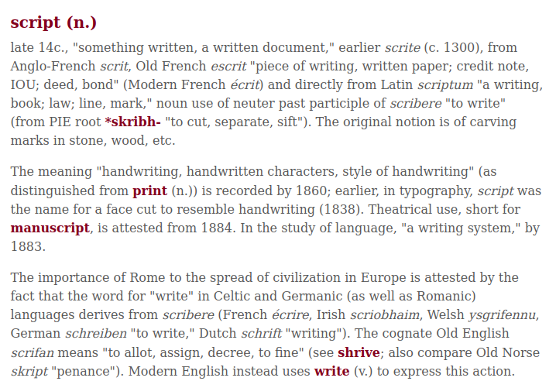

Etymology
https://www.etymonline.com/word/script

Slide 6
Etymology
https://www.etymonline.com/word/script

Slide 7
Etymology
https://www.etymonline.com/word/script

Slide 8
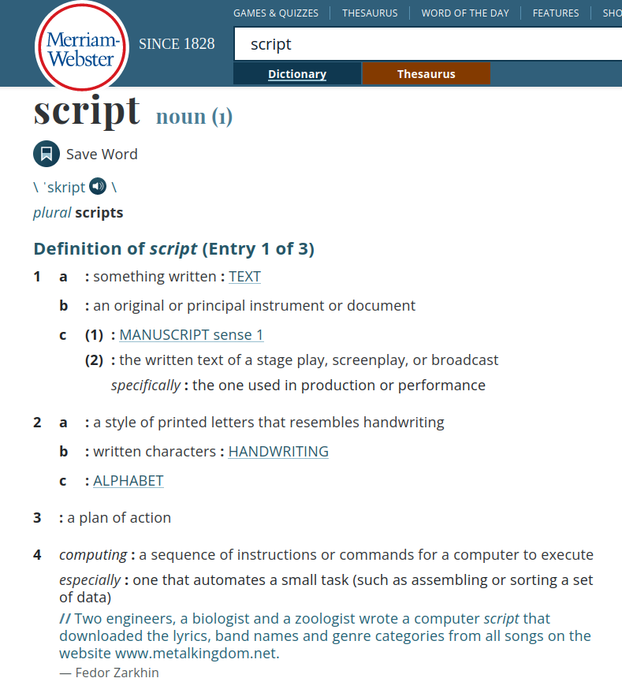

Definition
https://www.merriam-webster.com/dictionary/script

Slide 9
Definition
https://www.merriam-webster.com/dictionary/script

Slide 10
Definition
https://www.merriam-webster.com/dictionary/script

Slide 11

Definition
https://www.merriam-webster.com/dictionary/script

Slide 12
Definition
https://www.merriam-webster.com/dictionary/script

Slide 13
Definition
https://www.merriam-webster.com/dictionary/script

Slide 14

How to write a script?

Slide 15
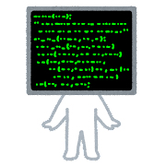
Scripting Language
# example_bash_script.sh
#!/bin/bash
while true; do
git status
read -p "Do you wish to create $1? [y/n] " yn
case $yn in
[Yy]* ) break;;
[Nn]* ) exit 1;;
* ) echo "Please answer yes or no.";;
esac
done
# echo "created $1"
git branch $1
git checkout $1
git push --set-upstream origin $1
Bash / Shell

Slide 16
But we already know a scripting language!

Slide 17
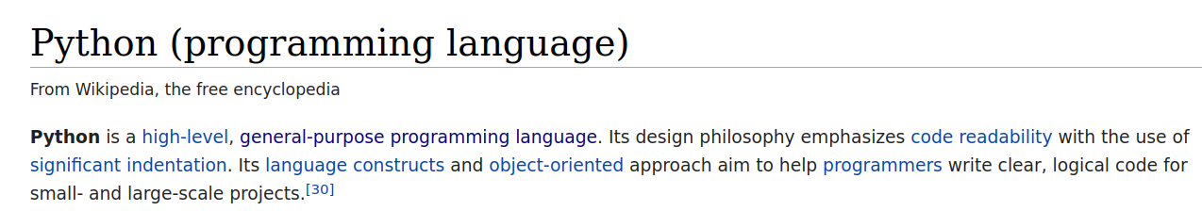

But we already know a scripting language!

Slide 18
But we already know a scripting language!

Slide 19
But we already know a scripting language!

Slide 20
But we already know a scripting language!

Slide 21
But we already know a scripting language!

Slide 22
But we already know a scripting language!

Slide 23

Python Example
class BlockManager(DataManager):
def __setstate__(self, state):
def unpickle_block(values, mgr_locs, ndim: int):
# TODO(EA2D): ndim would be unnecessary with 2D EAs
return make_block(values, placement=mgr_locs, ndim=ndim)
if isinstance(state, tuple) and len(state) >= 4 and "0.14.1" in state[3]:
state = state[3]["0.14.1"]
self.axes = [ensure_index(ax) for ax in state["axes"]]
ndim = len(self.axes)
self.blocks = tuple(
unpickle_block(b["values"], b["mgr_locs"], ndim=ndim)
for b in state["blocks"]
)
else:
raise NotImplementedError("pre-0.14.1 pickles are no longer supported")
self._post_setstate()
def _post_setstate(self) -> None:
...
https://github.com/pandas-dev/pandas/blob/9a678df32112fdac7fa082954dd4b44f82d9301c/pandas/core/internals/managers.py#L62

Slide 24
Python Example
class BlockManager(DataManager):
def __setstate__(self, state):
def unpickle_block(values, mgr_locs, ndim: int):
# TODO(EA2D): ndim would be unnecessary with 2D EAs
return make_block(values, placement=mgr_locs, ndim=ndim)
if isinstance(state, tuple) and len(state) >= 4 and "0.14.1" in state[3]:
state = state[3]["0.14.1"]
self.axes = [ensure_index(ax) for ax in state["axes"]]
ndim = len(self.axes)
self.blocks = tuple(
unpickle_block(b["values"], b["mgr_locs"], ndim=ndim)
for b in state["blocks"]
)
else:
raise NotImplementedError("pre-0.14.1 pickles are no longer supported")
self._post_setstate()
def _post_setstate(self) -> None:
...
https://github.com/pandas-dev/pandas/blob/9a678df32112fdac7fa082954dd4b44f82d9301c/pandas/core/internals/managers.py#L62

Slide 25
But we already know a scripting language!

Slide 26

Small Scale
# simple_script.py
print(5 + 10)

Slide 27
Small Scale
# simple_script.py
print(5 + 10)
# command line
python simple_script.py
15
Notes:
Congratulations, we’ve run our first script!
Note: the command is just python simple_script, .env-tf_talk is the venv, $ is just a common marker to put at the beginning of the command line. On windows, just open anaconda prompt and run simple script

Slide 28
Going Further: Simple Script

Slide 29

Simple Script
# simple_script.py
print(5 + 10)
# command line
python simple_script.py
15
Notes:
Congratulations, we’ve run our first script!
Note: the command is just python simple_script, .env-tf_talk is the venv, $ is just a common marker to put at the beginning of the command line. On windows, just open anaconda prompt and run simple script

Slide 30
Simple Script
# simple_script_1.py
user_number = input("What number? ")
print(user_number + 10)
Notes:
Congratulations, we’ve run our first script!
Note: the command is just python simple_script, .env-tf_talk is the venv, $ is just a common marker to put at the beginning of the command line. On windows, just open anaconda prompt and run simple script

Slide 31
Simple Script
# simple_script_1.py
user_number = input("What number? ")
print(user_number + 10)
# command line
$ python simple_script_1.py
What number? 10
Traceback (most recent call last):
File "apps/simple_script/simple_script_1.py", line 2, in <module>
print(user_number + 10)
TypeError: can only concatenate str (not "int") to str
Notes:
Congratulations, we’ve run our first script!
Note: the command is just python simple_script, .env-tf_talk is the venv, $ is just a common marker to put at the beginning of the command line. On windows, just open anaconda prompt and run simple script

Slide 32
Simple Script
# simple_script_2.py
user_number = input("What number? ")
print(int(user_number) + 10)
# command line
$ python simple_script_2.py
What number? 10
20
Notes:
Congratulations, we’ve run our first script!
Note: the command is just python simple_script, .env-tf_talk is the venv, $ is just a common marker to put at the beginning of the command line. On windows, just open anaconda prompt and run simple script

Slide 33
Simple Script
# simple_script_3.py
import sys
print(int(sys.argv[1]) + 10)
Notes:
Congratulations, we’ve run our first script!
Note: the command is just python simple_script, .env-tf_talk is the venv, $ is just a common marker to put at the beginning of the command line. On windows, just open anaconda prompt and run simple script

Slide 34
Simple Script
# simple_script_3.py
import sys
print(int(sys.argv[1]) + 10)
# command line
$ python simple_script_3.py 10
20
Notes:
Congratulations, we’ve run our first script!
Note: the command is just python simple_script, .env-tf_talk is the venv, $ is just a common marker to put at the beginning of the command line. On windows, just open anaconda prompt and run simple script

Slide 35
Simple Script
# simple_script_3.py
import sys
print(sys.argv) # for inspection
print(int(sys.argv[1]) + 10)
# command line
$ python simple_script_3.py 10
['simple_script_3.py', '10']
20
Notes:
Congratulations, we’ve run our first script!
Note: the command is just python simple_script, .env-tf_talk is the venv, $ is just a common marker to put at the beginning of the command line. On windows, just open anaconda prompt and run simple script

Slide 36
Conclusion
# simple_script_3.py
import sys
print(sys.argv) # for inspection
print(int(sys.argv[1]) + 10)
# command line
$ python simple_script_3.py 10
['simple_script_3.py', '10']
20
scripts
input
sys.argv
Notes:
Congratulations, we’ve run our first script!
Note: the command is just python simple_script, .env-tf_talk is the venv, $ is just a common marker to put at the beginning of the command line. On windows, just open anaconda prompt and run simple script

Slide 37

Time Logging (JLog): Demo

Slide 38
JLog (Demo)
# command line
$ python jlog.py
log: newday
note? yesterday I had coco curry for dinner
Yesterday, worked on tasks A B C
Today, will continue those tasks
Next meeting: tech talk 14:00
Next meeting:
[ ] will continue those tasks # 18:05
log: currently working on task A
18:08 - currently working on task A
log: q
$

Slide 39
JLog (Demo)
# jlog_output.txt
---04/20/2022 (Wednesday)--- yesterday I had coco curry for dinner
in 18:05
Yesterday, worked on tasks A B C
Today, will continue those tasks
> tech talk 14:00
--- 04/20/2022 (Wednesday) tech talk 14:00 ---
<<<<<<<<<<<<<<<<<<<<<<<<<<<<<<<<<<<<
TODO:
[ ] will continue those tasks # 18:05
18:05 - finished checkin
18:08 - currently working on task A

Slide 40
JLog Origins
# my_daily_log.txt
---04/20/2022 (Wednesday)---
18:05 - finished checkin
18:08 - currently working on task A

Slide 41
JLog Goals
# my_daily_log.txt
---04/20/2022 (Wednesday)---
18:05 - finished checkin
18:08 - currently working on task A
Input loops
Datetime module
Writing to a file

Slide 42
JLog
# jlog_0.py
OUTPATH = "output/my_logs_0.txt"
while True:
user_input = input("log: ")
with open(OUTPATH, mode="a") as f:
print(user_input, file=f)
print(user_input)

Slide 43
JLog
# jlog_0.py
OUTPATH = "output/my_logs_0.txt"
while True:
user_input = input("log: ")
with open(OUTPATH, mode="a") as f:
print(user_input, file=f)
print(user_input)

Slide 44
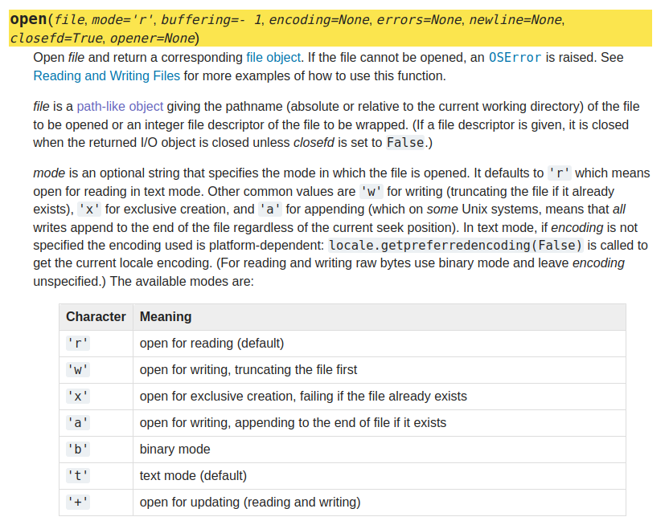
JLog
https://docs.python.org/3/library/functions.html#open

Slide 45
JLog
https://docs.python.org/3/library/functions.html#open

Slide 46
JLog
# jlog_0.py
OUTPATH = "output/my_logs_0.txt"
while True:
user_input = input("log: ")
with open(OUTPATH, mode="a") as f:
print(user_input, file=f)
print(user_input)
# command line
$ python apps/jlog/jlog_0.py
log: test 1
test 1
log: test 2
test 2
$ cat output/my_logs_0.txt
test 1
test 2

Slide 47
JLog
# jlog_1.py
from datetime import datetime
OUTPATH = "output/my_logs_1.txt"
def main():
while True:
user_input = input("log: ")
log = f"{datetime.now()} - {user_input}"
with open(OUTPATH, mode="a") as f:
f.write(f"{log}\n")
print(log)
if __name__ == "__main__":
main()

Slide 48
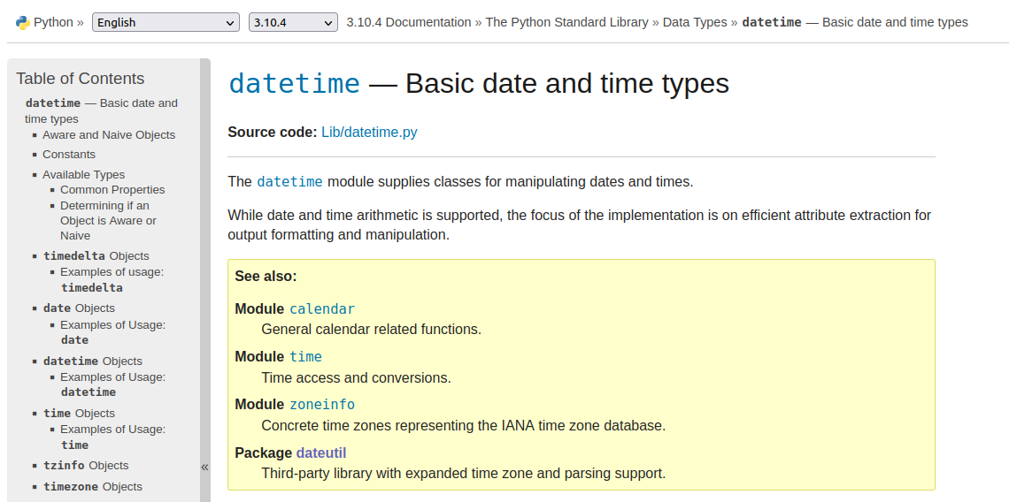
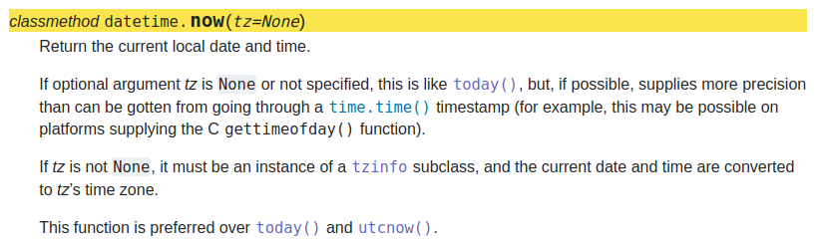
JLog

Slide 49
JLog
# jlog_1.py
...
def main():
while True:
user_input = input("log: ")
log = f"{datetime.now()} - {user_input}"
with open(OUTPATH, mode="a") as f:
f.write(f"{log}\n")
print(log)
...
# command line
$ python jlog_1.py
log: finish presentation
2022-04-20 18:47:56.725245 - finish presentation
log: play with my cats
2022-04-20 18:48:00.552193 - play with my cats
$ cat output/my_logs_1.txt
2022-04-20 18:47:56.725245 - finish presentation
2022-04-20 18:48:00.552193 - play with my cats

Slide 50
Conclusion
# jlog_1.py
...
def main():
while True:
user_input = input("log: ")
log = f"{datetime.now()} - {user_input}"
with open(OUTPATH, mode="a") as f:
f.write(f"{log}\n")
print(log)
...
Input loops
Datetime module
Writing to a file
# command line
$ python jlog_1.py
log: finish presentation
2022-04-20 18:47:56.725245 - finish presentation
log: play with my cats
2022-04-20 18:48:00.552193 - play with my cats
$ cat output/my_logs_1.txt
2022-04-20 18:47:56.725245 - finish presentation
2022-04-20 18:48:00.552193 - play with my cats

Slide 51

Image Sorting: Demo

Slide 52
Images (Demo)
# jlog_0.py
$ tree input/
input/
├── Cryptocurrencies The Power of Memes | Research Affiliates.html
├── ESG Is a Preference, Not a Strategy | Research Affiliates.html
├── example_log.txt
├── img001.jpg
├── img004.jpg
├── img007.jpg
├── IMG_20220414_095327 (1).jpg
├── img219.jpg
├── presentation.md
└── ra_cryptocurrencies.txt

Slide 53
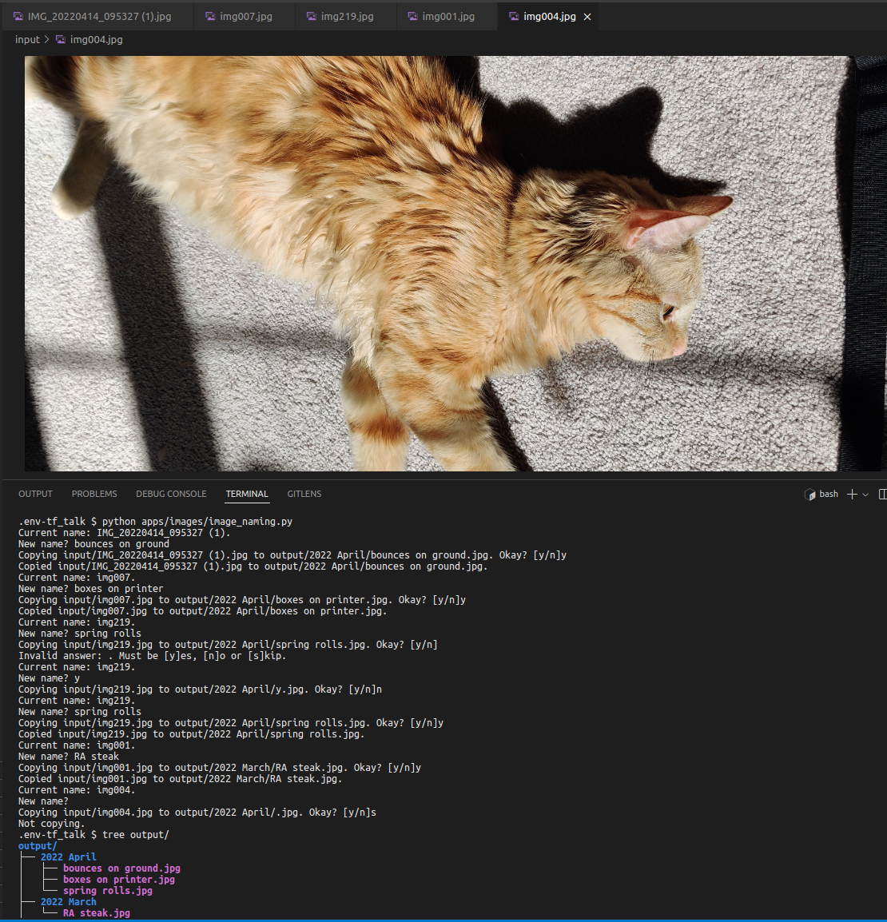
Images (Demo)
.env-tf_talk $ python apps/images/image_naming.py
Current name: IMG_20220414_095327 (1).
New name? bounces on ground
Copying input/IMG_20220414_095327 (1).jpg to output/2022 April/bounces on ground.jpg. Okay? [y/n]y
Copied input/IMG_20220414_095327 (1).jpg to output/2022 April/bounces on ground.jpg.
Current name: img007.
New name? boxes on printer
Copying input/img007.jpg to output/2022 April/boxes on printer.jpg. Okay? [y/n]y
Copied input/img007.jpg to output/2022 April/boxes on printer.jpg.
Current name: img219.
New name? spring rolls
Copying input/img219.jpg to output/2022 April/spring rolls.jpg. Okay? [y/n]
Invalid answer: . Must be [y]es, [n]o or [s]kip.
Current name: img219.
New name? y
Copying input/img219.jpg to output/2022 April/y.jpg. Okay? [y/n]n
Current name: img219.
New name? spring rolls
Copying input/img219.jpg to output/2022 April/spring rolls.jpg. Okay? [y/n]y
Copied input/img219.jpg to output/2022 April/spring rolls.jpg.
Current name: img001.
New name? RA steak
Copying input/img001.jpg to output/2022 March/RA steak.jpg. Okay? [y/n]y
Copied input/img001.jpg to output/2022 March/RA steak.jpg.
Current name: img004.
New name?
Copying input/img004.jpg to output/2022 April/.jpg. Okay? [y/n]s
Not copying.
Input loops
Datetime module
Writing to a file

Slide 54
Images (Demo)
.env-tf_talk $ tree output/
output/
├── 2022 April
│ ├── bounces on ground.jpg
│ ├── boxes on printer.jpg
│ └── spring rolls.jpg
├── 2022 March
│ └── RA steak.jpg
Input loops
Datetime module
Writing to a file

Slide 55
Images Goals
.env-tf_talk $ tree output/
output/
├── 2022 April
│ ├── bounces on ground.jpg
│ ├── boxes on printer.jpg
│ └── spring rolls.jpg
├── 2022 March
│ └── RA steak.jpg
pathlib.Path
PIL.Image
datetime.strptime

Slide 56
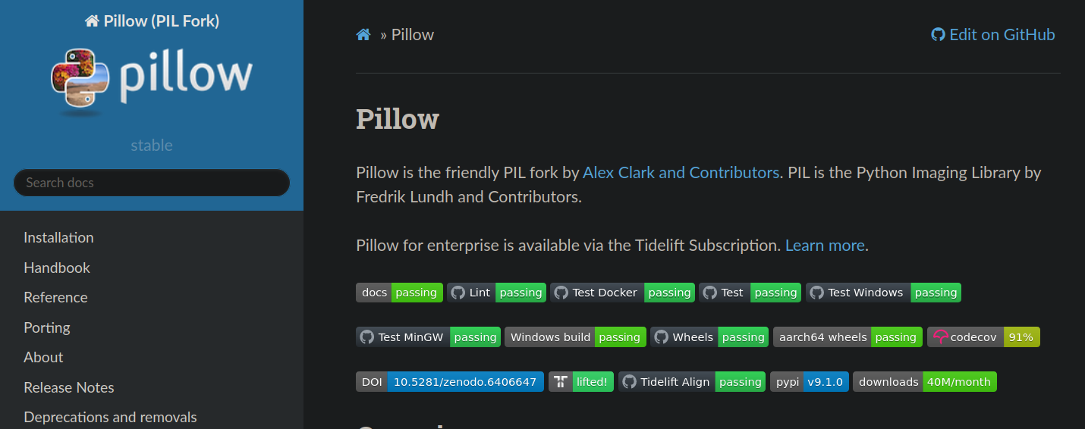
PIL(low)
https://pillow.readthedocs.io/en/stable/index.html

Slide 57

Do not install arbitrary packages on your RA platform
PIL(low)
https://pillow.readthedocs.io/en/stable/index.html

Slide 58
Do not install arbitrary packages on your RA platform
PIL(low)
https://pillow.readthedocs.io/en/stable/index.html
(.env38) $ python -m venv ~/.env-simple_scripting_tf_talk
(.env38) $ . ~/.env-simple_scripting_tf_talk/bin/activate
(.env-simple_scripting_tf_talk) $ pip freeze
(.env-simple_scripting_tf_talk) $ pip install Pillow
Collecting Pillow
Using cached Pillow-9.1.0-cp38-cp38-manylinux_2_17_x86_64.manylinux2014_x86_64.whl (4.3 MB)
Installing collected packages: Pillow
Successfully installed Pillow-9.1.0
WARNING: You are using pip version 21.1.1; however, version 22.0.4 is available.
You should consider upgrading via the '/home/mccloskey/.env-simple_scripting_tf_talk/bin/python -m pip install --upgrade pip' command.
(.env-simple_scripting_tf_talk) $ pip freeze
Pillow==9.1.0

Slide 59
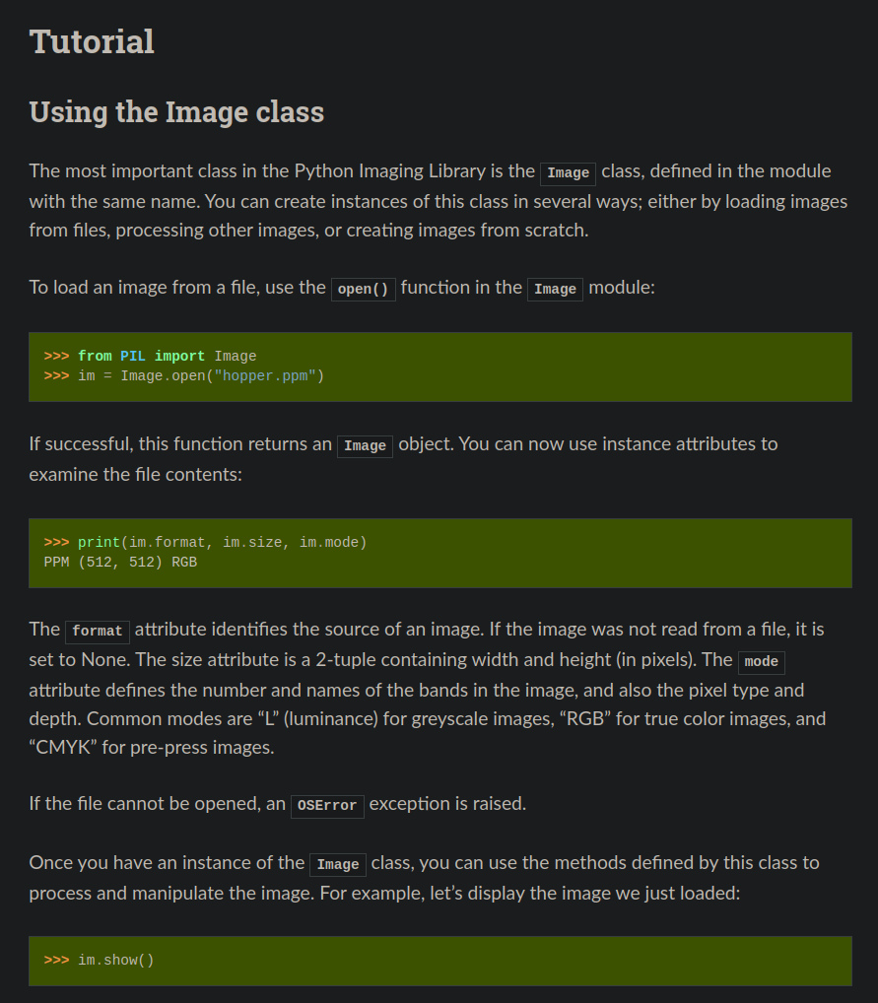
PIL(low)
https://pillow.readthedocs.io/en/stable/handbook/tutorial.html

Slide 60
PIL(low)
https://pillow.readthedocs.io/en/stable/handbook/tutorial.html

Slide 61
Images
# images.py
from pathlib import Path
import shutil
from PIL import Image
input_path = Path("input")
output_path = Path("output")
output_path.mkdir(exist_ok=True)
for path in input_path.iterdir():
if path.suffix != ".jpg":
continue
Image.open(path).show()
new_name = input(f"Current name: {path.stem}.\nNew name? ")
new_path = output_path / f"{new_name}{path.suffix}"
shutil.copyfile(path, new_path)
print(f"Copied {path} to {new_path}. ")

Slide 62
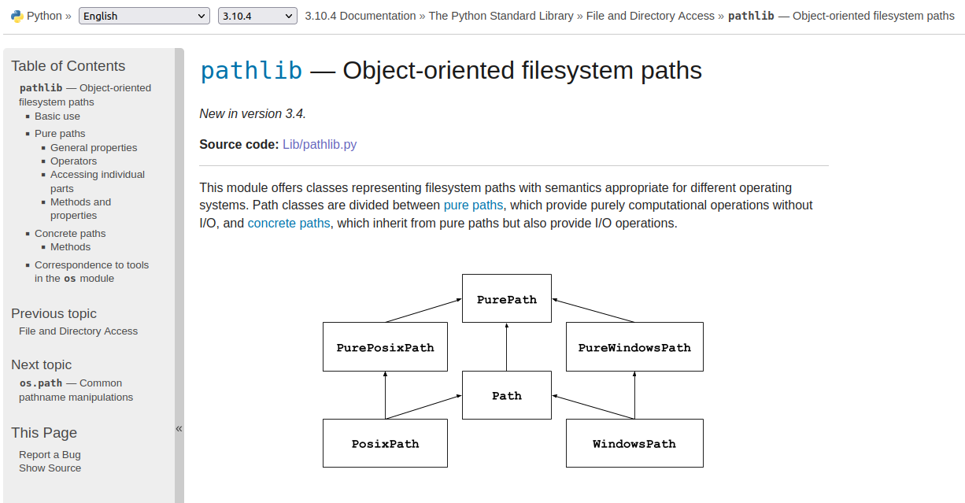
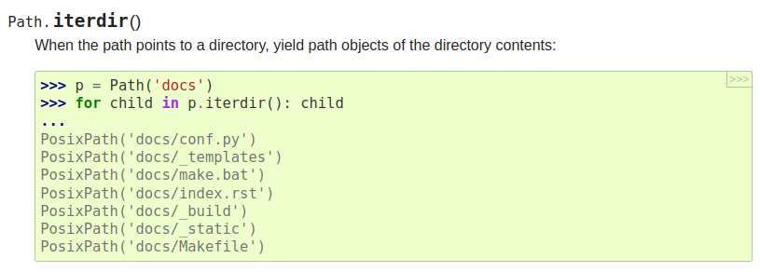
pathlib
https://docs.python.org/3/library/pathlib.html

Slide 63
Images
# images.py
from pathlib import Path
import shutil
from PIL import Image
input_path = Path("input")
output_path = Path("output")
output_path.mkdir(exist_ok=True)
for path in input_path.iterdir():
if path.suffix != ".jpg":
continue
Image.open(path).show()
new_name = input(f"Current name: {path.stem}.\nNew name? ")
new_path = output_path / f"{new_name}{path.suffix}"
shutil.copyfile(path, new_path)
print(f"Copied {path} to {new_path}. ")

Slide 64
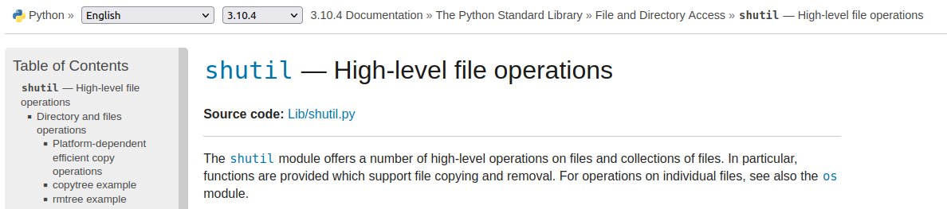
shutil
https://docs.python.org/3/library/pathlib.html

Slide 65
Images
# images.py
from pathlib import Path
import shutil
from PIL import Image
input_path = Path("input")
output_path = Path("output")
output_path.mkdir(exist_ok=True)
for path in input_path.iterdir():
if path.suffix != ".jpg":
continue
Image.open(path).show()
new_name = input(f"Current name: {path.stem}.\nNew name? ")
new_path = output_path / f"{new_name}{path.suffix}"
shutil.copyfile(path, new_path)
print(f"Copied {path} to {new_path}. ")

Slide 66
Images
# images.py
...
image.show()
while True:
new_name = input(f"Current name: {path.stem}.\nNew name? ")
new_path = output_path / f"{new_name}{path.suffix}"
msg = f"Copying {path} to {new_path}. "
if new_path.exists():
msg += f"WARNING: {new_path} already exists. "
answer = input(msg + "Okay? [y/n]").lower()
if answer in {"y", "yes"}:
shutil.copyfile(path, new_path)
print(f"Copied {path} to {new_path}. ")
break
elif answer in {"n", "no"}:
pass
elif answer in {"s", "skip"}:
print("Not copying.")
break
else:
print(f"Invalid answer: {answer}. Must be [y]es, [n]o or [s]kip.")

Slide 67
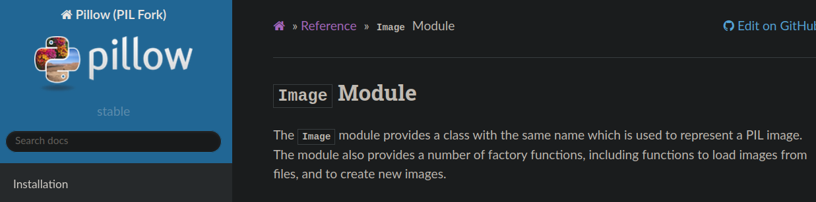

Images
https://pillow.readthedocs.io/en/stable/reference/Image.html

Slide 68
Images
>>> Image.open(path).getexif()
# {296: 2, 282: 72.0, 256: 4000, 257: 1824, 34853: 788, 34665: 240, 271: 'OnePlus', 272: 'GM1917', 305: 'Picasa', 274: 1, 306: '2022:04:14 09:53:28', 530: (2, 2), 531: 1, 283: 72.0}

Slide 69
Images
>>> Image.open(path).getexif()
# {296: 2, 282: 72.0, 256: 4000, 257: 1824, 34853: 788, 34665: 240, 271: 'OnePlus', 272: 'GM1917', 305: 'Picasa', 274: 1, 306: '2022:04:14 09:53:28', 530: (2, 2), 531: 1, 283: 72.0}
# we want (year, month), like 2022 April
def extract_month(image: Image.Image) -> str | None:
metadata = image.getexif()
if 306 not in metadata:
return None
timestamp_text = metadata[306]
try:
timestamp = datetime.strptime(timestamp_text, "%Y:%m:%d %H:%M:%S")
except ValueError:
return None
return timestamp.strftime("%Y %B")

Slide 70
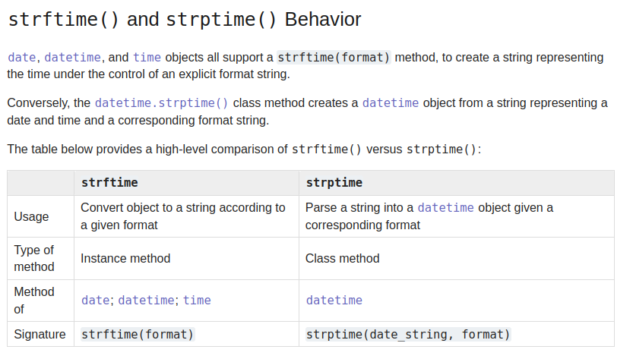
strftime / strptime
https://docs.python.org/3/library/datetime.html#strftime-strptime-behavior

Slide 71
strftime / strptime
https://docs.python.org/3/library/datetime.html#strftime-strptime-behavior

Slide 72
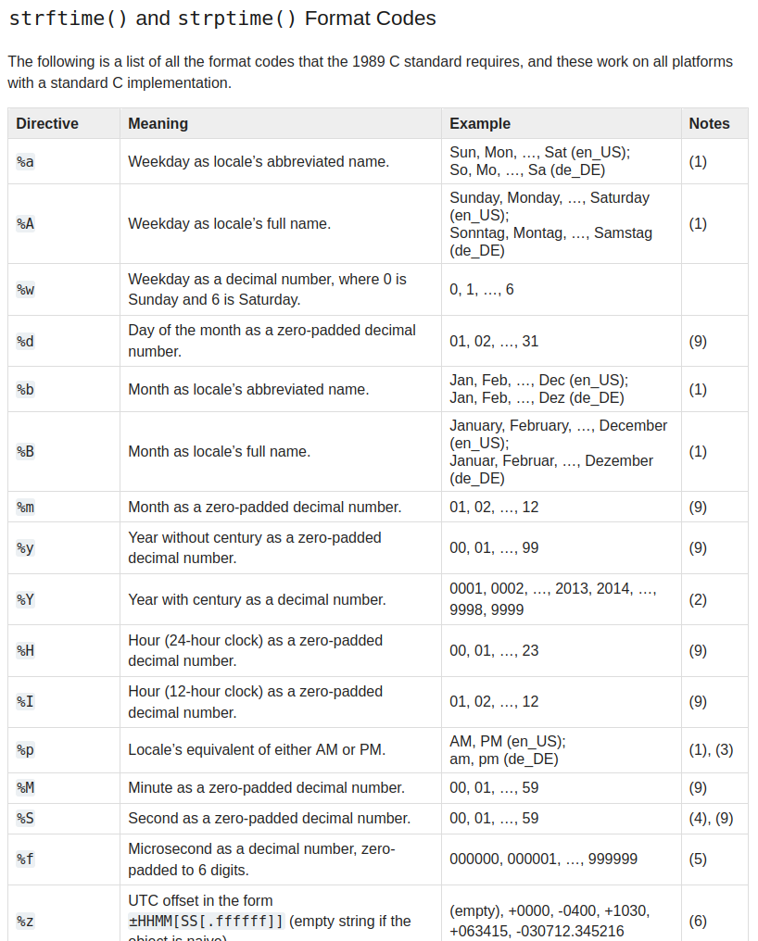
strftime / strptime
https://docs.python.org/3/library/datetime.html#strftime-and-strptime-format-codes

Slide 73
>>> Image.open(path).getexif()
# {296: 2, 282: 72.0, 256: 4000, 257: 1824, 34853: 788, 34665: 240, 271: 'OnePlus', 272: 'GM1917', 305: 'Picasa', 274: 1, 306: '2022:04:14 09:53:28', 530: (2, 2), 531: 1, 283: 72.0}
# we want (year, month), like 2022 April
def extract_month(image: Image.Image) -> str | None:
metadata = image.getexif()
if 306 not in metadata:
return None
timestamp_text = metadata[306]
try:
timestamp = datetime.strptime(timestamp_text, "%Y:%m:%d %H:%M:%S")
except ValueError:
return None
return timestamp.strftime("%Y %B")

Slide 74
Images
# images.py
...
for path in input_path.iterdir():
if path.suffix != ".jpg":
continue
image = Image.open(path)
subprocess.run(["code", path]) # for WSL, open in vscode server
# image.show() # for Windows/Linux/Mac
month = extract_month(image)
month_path = output_path if month is None else output_path / month
month_path.mkdir(parents=True, exist_ok=True)
while True:
new_name = input(f"Current name: {path.stem}.\nNew name? ")
new_path = month_path / f"{new_name}{path.suffix}"
...

Slide 75
Conclusion
# images.py
...
for path in input_path.iterdir():
if path.suffix != ".jpg":
continue
image = Image.open(path)
subprocess.run(["code", path]) # for WSL, open in vscode server
# image.show() # for Windows/Linux/Mac
month = extract_month(image)
month_path = output_path if month is None else output_path / month
month_path.mkdir(parents=True, exist_ok=True)
while True:
new_name = input(f"Current name: {path.stem}.\nNew name? ")
new_path = month_path / f"{new_name}{path.suffix}"
...
pathlib.Path
PIL.Image
datetime.strptime

Slide 76

APIs (Jisho)

Slide 77
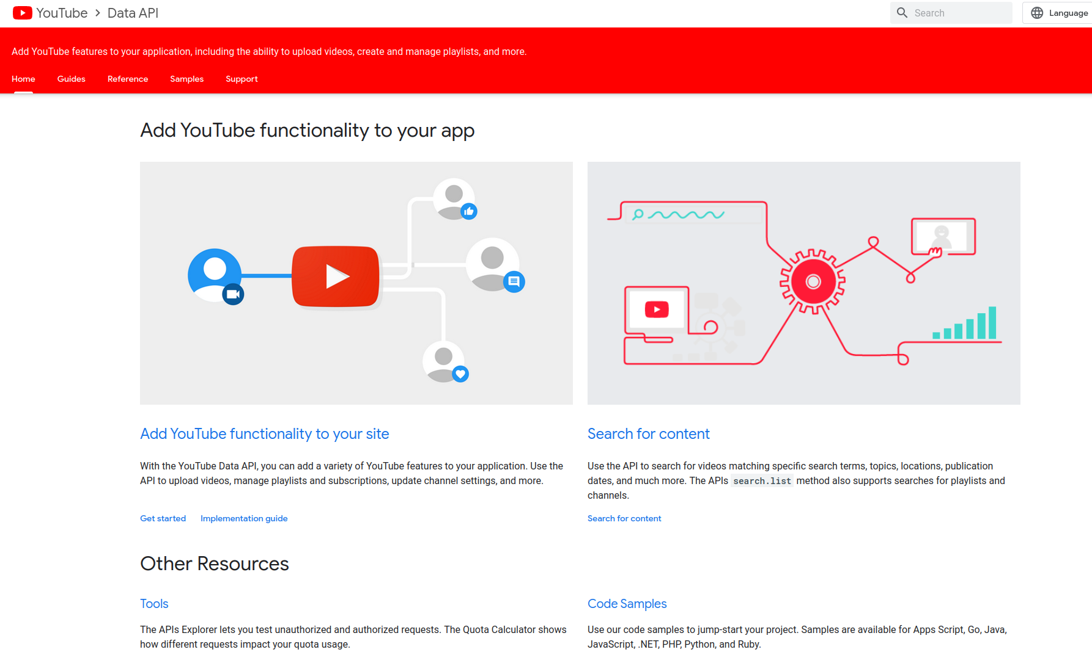

Other APIs

Slide 78
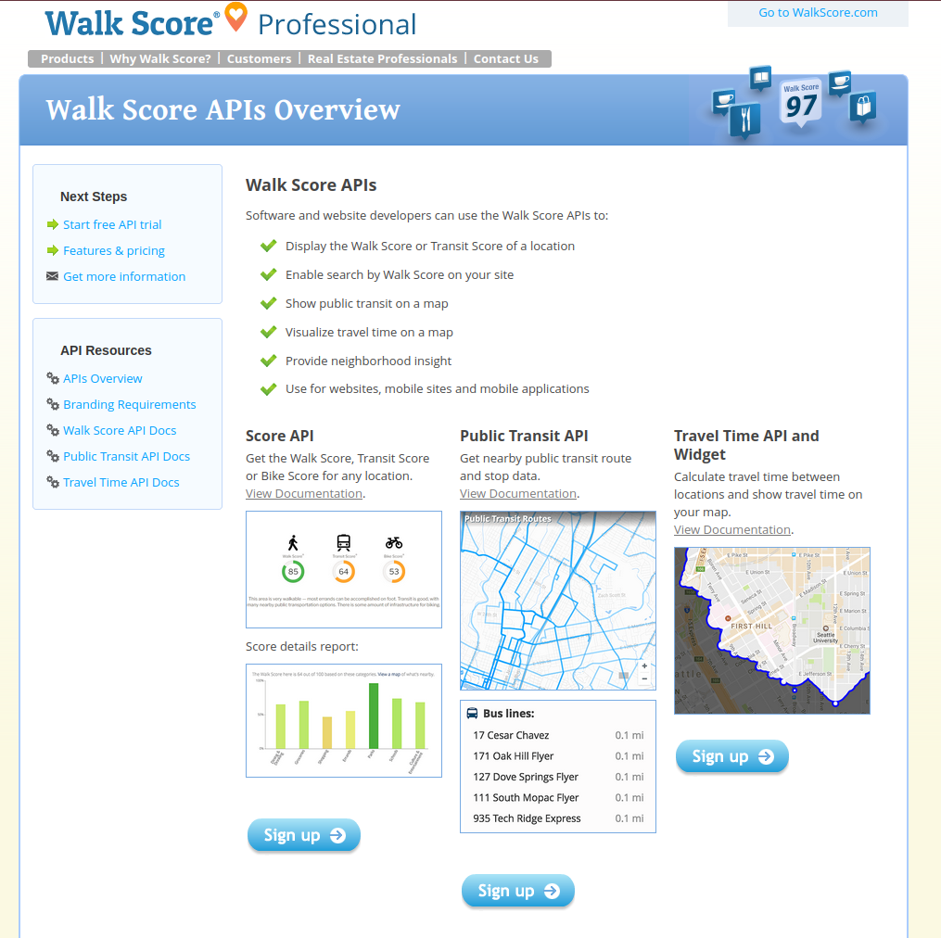
Other APIs

Slide 79
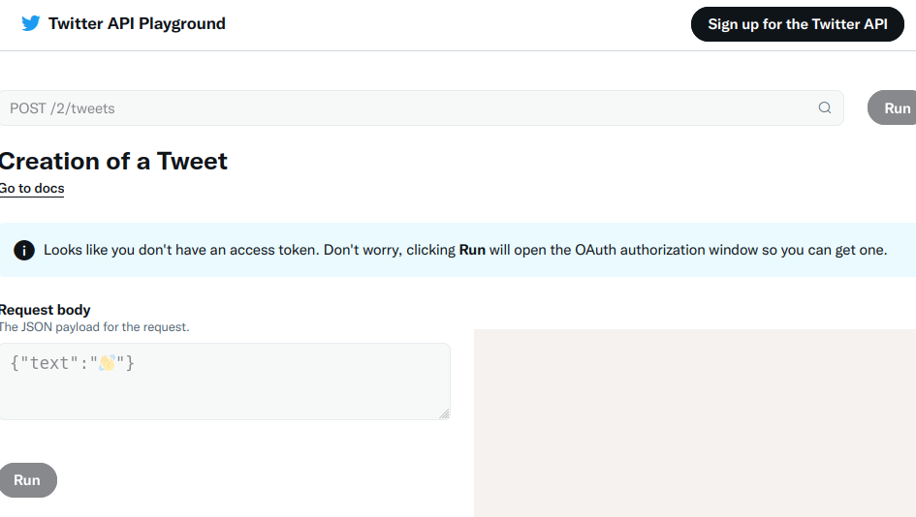
Other APIs

Slide 80
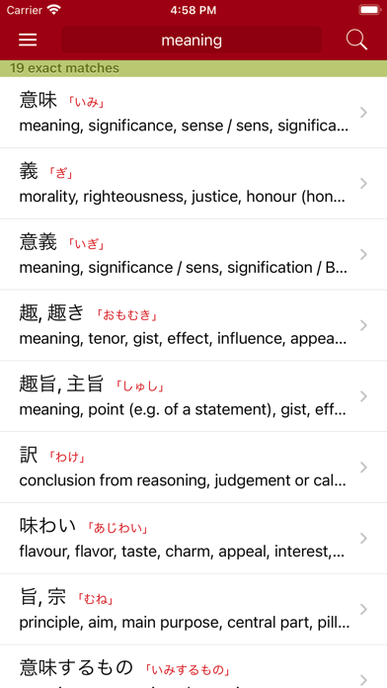
Jisho Origins: imiwa
https://is2-ssl.mzstatic.com/image/thumb/PurpleSource114/v4/a2/b0/31/a2b03127-f76a-fda6-8cbe-2dc4010b3ae3/ac3b9f29-8667-440e-b438-afa6fe2137cb_iPhone_8_Plus-00-Dictionary_search.png/392x696bb.png

Slide 81
Jisho Origins: imiwa
https://is2-ssl.mzstatic.com/image/thumb/PurpleSource114/v4/a2/b0/31/a2b03127-f76a-fda6-8cbe-2dc4010b3ae3/ac3b9f29-8667-440e-b438-afa6fe2137cb_iPhone_8_Plus-00-Dictionary_search.png/392x696bb.png

Slide 82
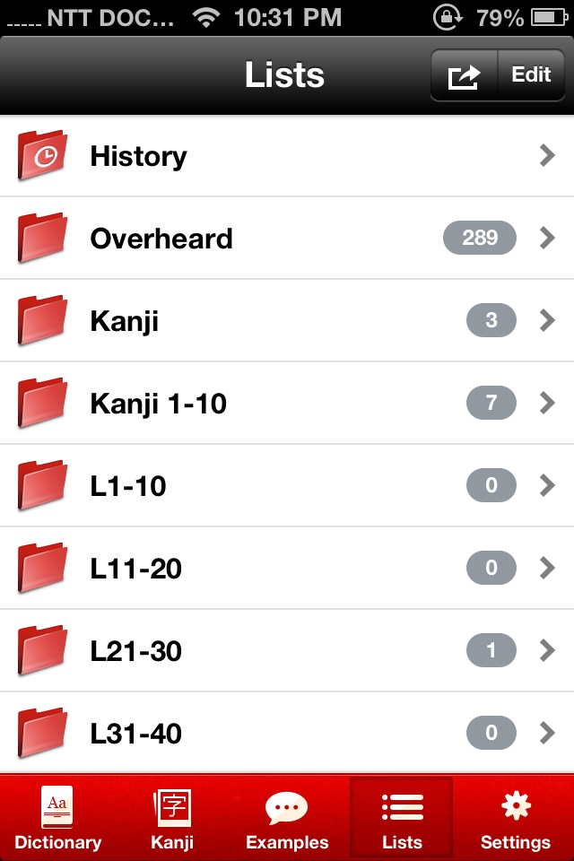
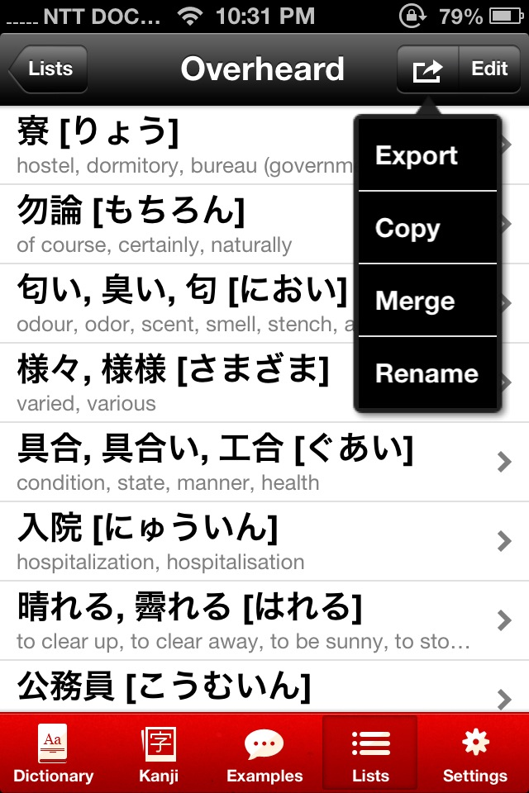
Jisho Origins: imiwa
https://www.davidbcalhoun.com/wp-content/uploads/2013/02/imiwa-ios-list.jpg
https://www.davidbcalhoun.com/wp-content/uploads/2013/02/imiwa-ios-list-export.jpg

Slide 83
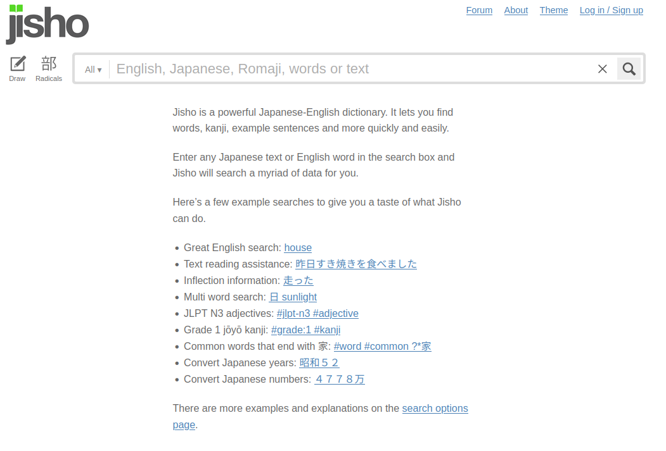
Jisho
https://jisho.org/

Slide 84
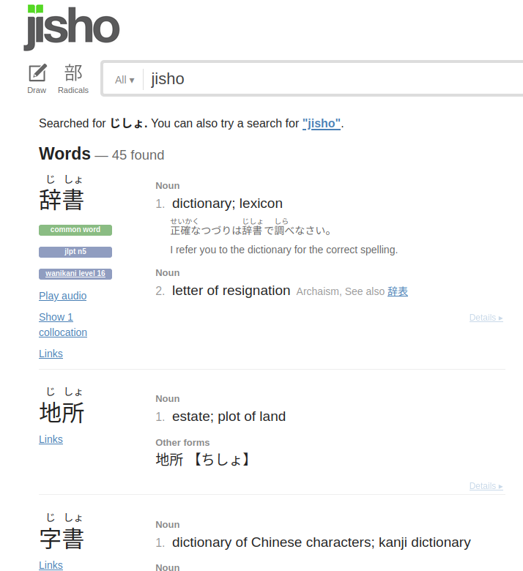
Jisho
https://jisho.org/search/jisho

Slide 85
Jisho: Demo

Slide 86
Jisho (Demo)
.env-tf_talk $ python sketch/jisho_og.py
Welcome to John's Jisho. Type .h for help.
Loaded Favorites from output/jisho/lists.json.
[Favorites]> .h
John's Jisho.
Current list: Favorites
Current json: output/jisho/lists.json
Type in a keyword or a special argument. Arguments
Q: quit
.H: helpstring
.CL <list>: change list to <list>
.NL <list>: create new list <list>
.SL: show current list
.EL: export list
M: more definitions
letter+number combo: save word-sense pair to list.
[Favorites]> jisho
...

Slide 87
Jisho (Demo)
[Favorites]> jisho
jisho
Showing entries 1-5/10
A. 辞書 (じしょ)
(1) dictionary, lexicon; (2) letter of resignation
B. 地所 (じしょ); 地所 (ちしょ)
(1) estate, plot of land
C. 字書 (じしょ)
(1) dictionary of Chinese characters, kanji dictionary; (2) dictionary; (3) Chinese dictionary
D. 自署 (じしょ)
(1) autograph, signature
E. 自書 (じしょ)
(1) one's own writing
Press m to show more
[Favorites]> a1
Saved to Favorites. 辞書:dictionary, lexicon.
[Favorites]> .sl
Favorites:
1. 辞書 じしょ dictionary.

Slide 88
Jisho: Goals
[Favorites]> jisho
jisho
Showing entries 1-5/10
A. 辞書 (じしょ)
(1) dictionary, lexicon; (2) letter of resignation
B. 地所 (じしょ); 地所 (ちしょ)
(1) estate, plot of land
C. 字書 (じしょ)
(1) dictionary of Chinese characters, kanji dictionary; (2) dictionary; (3) Chinese dictionary
D. 自署 (じしょ)
(1) autograph, signature
E. 自書 (じしょ)
(1) one's own writing
Press m to show more
[Favorites]> a1
Saved to Favorites. 辞書:dictionary, lexicon.
[Favorites]> .sl
Favorites:
1. 辞書 じしょ dictionary.
JSON
requests

Slide 89
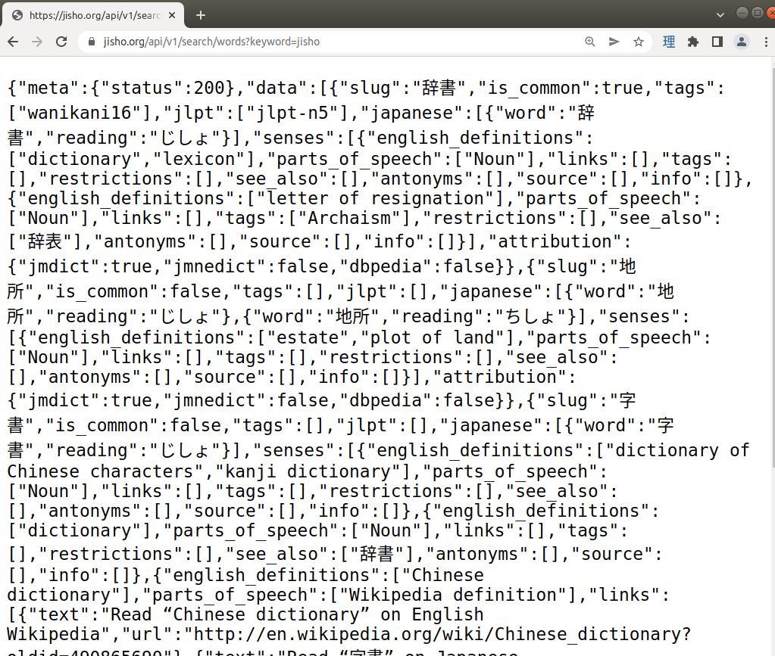
Jisho: API
https://jisho.org/api/v1/search/words?keyword=jisho

Slide 90
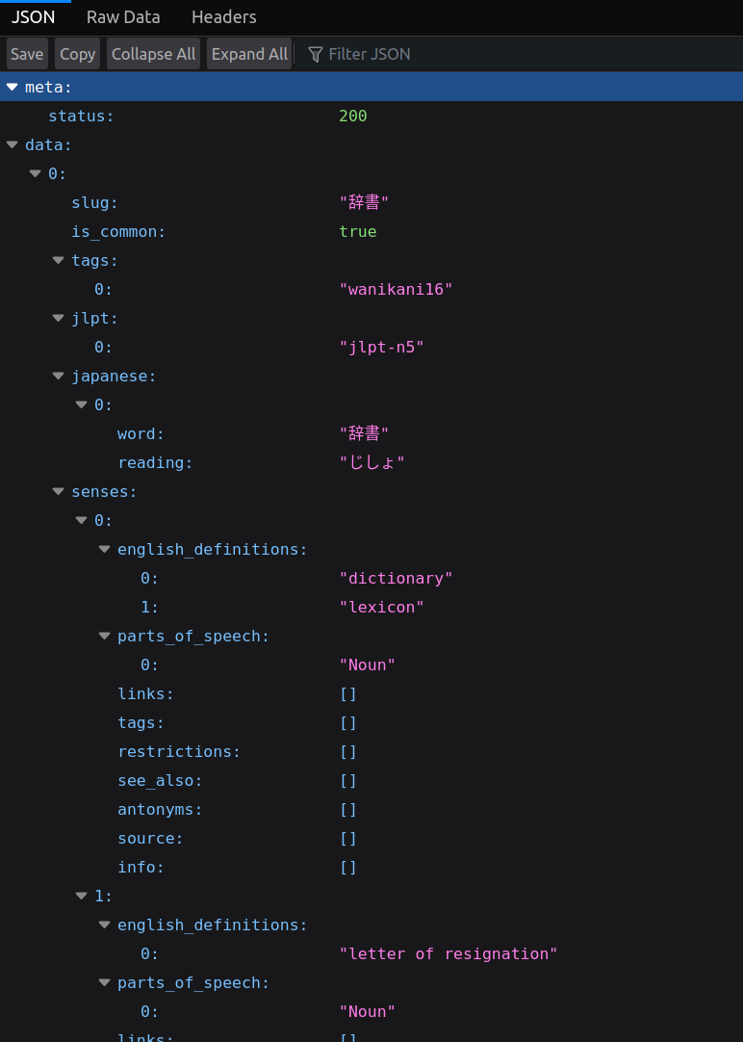
Jisho: API
https://jisho.org/api/v1/search/words?keyword=jisho

Slide 91
Jisho
# jisho.py
import requests
import typing as tp
BASE_URL = "https://jisho.org/api/v1/search"
def call_api(keyword: str) -> dict[str, tp.Any]:
response = requests.get(f"{BASE_URL}/words?keyword={keyword}")
response.raise_for_status()
return response.json()
def main() -> None:
keyword = input("Keyword? ")
print(call_api(keyword))
if __name__ == "__main__":
main()
# command line
$ python jisho_0.py
Keyword? jisho
{'meta': {'status': 200}, 'data': [{'slug': '辞書', 'is_common': True, 'tags': ['wanikani16'], 'jlpt': ['jlpt-n5'], 'japanese': [{'word': '辞書', 'reading': 'じしょ'}], 'senses': [{'english_definitions': ...

Slide 92
Jisho
# jisho.py
...
def main() -> None:
keyword = input("Keyword? ")
print(json.dumps(call_api(keyword), indent=2, ensure_ascii=False))
...
# command line
$ python jisho_1.py
Keyword? jisho
{
"meta": {
"status": 200
},
"data": [
{
"slug": "辞書",
"is_common": true,
"tags": [
"wanikani16"
],
...

Slide 93
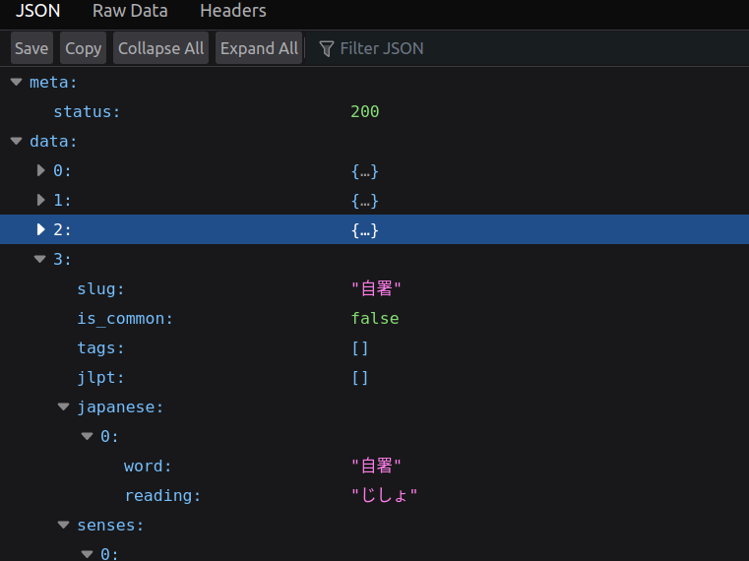
Jisho

Slide 94
Jisho
[Favorites]> jisho
jisho
Showing entries 1-5/10
A. 辞書 (じしょ)
(1) dictionary, lexicon; (2) letter of resignation
B. 地所 (じしょ); 地所 (ちしょ)
(1) estate, plot of land
C. 字書 (じしょ)
(1) dictionary of Chinese characters, kanji dictionary; (2) dictionary; (3) Chinese dictionary
D. 自署 (じしょ)
(1) autograph, signature
E. 自書 (じしょ)
(1) one's own writing
Press m to show more
[Favorites]> a1
Saved to Favorites. 辞書:dictionary, lexicon.
[Favorites]> .sl
Favorites:
1. 辞書 じしょ dictionary.

Slide 95
Jisho
# jisho.py
def parse_response(response_json: JsonT):
data = response_json["data"]
parsed_response = {}
for i, entry in enumerate(data, 1):
parsed_response[num_to_letter(i)] = parse_entry(entry)
return parsed_response
def num_to_letter(num: int) -> str:
return chr(num + 64)

Slide 96
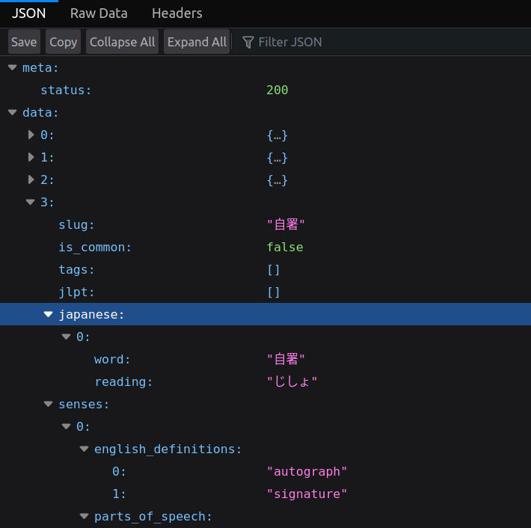
Jisho

Slide 97
Jisho
[Favorites]> jisho
jisho
Showing entries 1-5/10
A. 辞書 (じしょ)
(1) dictionary, lexicon; (2) letter of resignation
B. 地所 (じしょ); 地所 (ちしょ)
(1) estate, plot of land
C. 字書 (じしょ)
(1) dictionary of Chinese characters, kanji dictionary; (2) dictionary; (3) Chinese dictionary
D. 自署 (じしょ)
(1) autograph, signature
E. 自書 (じしょ)
(1) one's own writing
Press m to show more
[Favorites]> a1
Saved to Favorites. 辞書:dictionary, lexicon.
[Favorites]> .sl
Favorites:
1. 辞書 じしょ dictionary.

Slide 98
Jisho
# jisho.py
def parse_response(response_json: JsonT):
data = response_json["data"]
parsed_response = {}
for i, entry in enumerate(data, 1):
parsed_response[num_to_letter(i)] = parse_entry(entry)
return parsed_response
def parse_entry(entry: JsonT):
new_entry = {
"definitions": get_english_definitions(entry["senses"]),
"entry": entry["japanese"],
}
return new_entry
def get_english_definitions(senses: JsonT):
eng_definitions = {}
for i, sense in enumerate(senses, 1):
eng_definitions[i] = ", ".join(sense["english_definitions"])
return eng_definitions

Slide 99
Jisho
# command line
.env-tf_talk $ python jisho_2.py
Keyword? jisho
{
"A": {
"definitions": {
"1": "dictionary, lexicon",
"2": "letter of resignation"
},
"entry": [
{
"word": "辞書",
"reading": "じしょ"
}
]
},
"B": {
"definitions": {
"1": "estate, plot of land"
},
"entry": [
{
"word": "地所",
"reading": "じしょ"
},
{
"word": "地所",
"reading": "ちしょ"
...

Slide 100
Conclusion
# jisho.py
imports, constants
def get_english_definitions(senses: JsonT) -> str:
eng_definitions = {}
for i, sense in enumerate(senses, 1):
eng_definitions[i] = ", ".join(sense["english_definitions"])
return eng_definitions
def parse_entry(entry: JsonT) -> JsonT:
new_entry = {
"definitions": get_english_definitions(entry["senses"]),
"entry": entry["japanese"],
}
return new_entry
def parse_response(response_json: JsonT) -> JsonT:
data = response_json["data"]
parsed_response = {}
for i, entry in enumerate(data, 1):
parsed_response[num_to_letter(i)] = parse_entry(entry)
return parsed_response
def call_api(keyword: str) -> JsonT:
response = requests.get(f"{BASE_URL}/words?keyword={keyword}")
response.raise_for_status()
return response.json()
def main() -> None:
keyword = input("Keyword? ")
response_json = call_api(keyword)
print(json.dumps(parse_response(response_json), indent=2, ensure_ascii=False))
if __name__ == "__main__":
main()
JSON
requests

Slide 101

Ebook: Demo

Slide 102
Ebook (Demo)
# command line
$ python ebook_4.py
/home/mccloskey/src/john/techforum_talk/output/RA Publication Chapters.epub

Slide 103
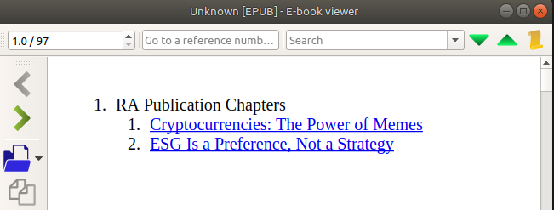
Ebook (Demo)

Slide 104
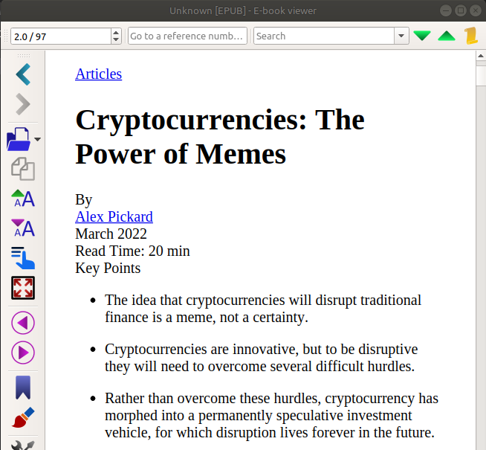
Ebook (Demo)
https://www.researchaffiliates.com/publications/articles/913-cryptocurrencies-the-power-of-memes

Slide 105
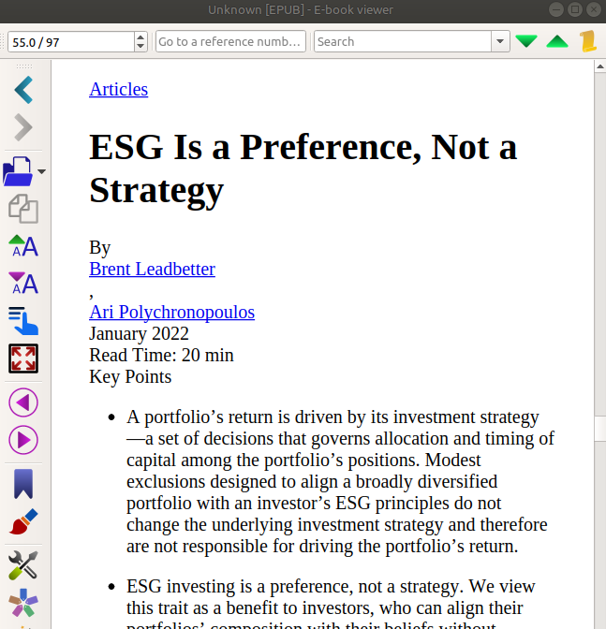
Ebook (Demo)
https://www.researchaffiliates.com/publications/articles/853-esg-is-a-preference-not-a-strategy

Slide 106
Ebook: Goals
# command line
$ python ebook_4.py
/home/mccloskey/src/john/techforum_talk/output/RA Publication Chapters.epub
ebooklib
beautifulsoup / html

Slide 107
Ebooklib
from ebooklib import epub
book = epub.EpubBook()
# set metadata
book.set_identifier('id123456')
book.set_title('Sample book')
book.set_language('en')
book.add_author('Author Authorowski')
book.add_author('Danko Bananko', file_as='Gospodin Danko Bananko', role='ill', uid='coauthor')
# create chapter
c1 = epub.EpubHtml(title='Intro', file_name='chap_01.xhtml', lang='hr')
c1.content=u'<h1>Intro heading</h1><p>Zaba je skocila u baru.</p>'
# add chapter
book.add_item(c1)
https://pypi.org/project/EbookLib/

Slide 108
Ebooklib
# define Table Of Contents
book.toc = (epub.Link('chap_01.xhtml', 'Introduction', 'intro'),
(epub.Section('Simple book'),
(c1, ))
)
# add default NCX and Nav file
book.add_item(epub.EpubNcx())
book.add_item(epub.EpubNav())
# define CSS style
style = 'BODY {color: white;}'
nav_css = epub.EpubItem(uid="style_nav", file_name="style/nav.css", media_type="text/css", content=style)
# add CSS file
book.add_item(nav_css)
# basic spine
book.spine = ['nav', c1]
# write to the file
epub.write_epub('test.epub', book, {})
https://pypi.org/project/EbookLib/

Slide 109
Ebook
# ebook.py
from ebooklib import epub
from pathlib import Path
OUTPUT_DIR = Path("output")
INPUT_DIR = Path("input")
def main(title: str, input_path: Path) -> Path:
# make chapter
chapter = epub.EpubHtml(
title=title, content=input_path.read_text(), file_name="file1.xhtml"
)
# make book
book = epub.EpubBook()
book.add_item(chapter)
book.spine = [chapter]
# write book
OUTPUT_DIR.mkdir(exist_ok=True)
output_path = OUTPUT_DIR / f"{title}.epub"
epub.write_epub(output_path, book)
return output_path
if __name__ == "__main__":
input_path = (
INPUT_DIR / "Cryptocurrencies The Power of Memes | Research Affiliates.html"
)
print(main(title="RA Crypto Currency Article HTML", input_path=input_path))

Slide 110
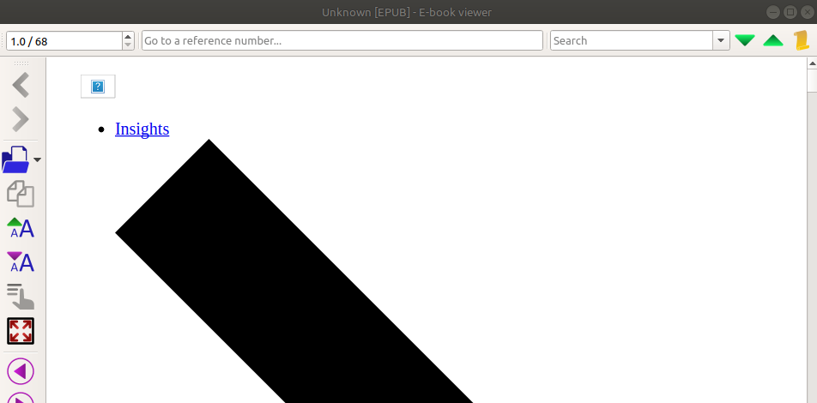
Ebook

Slide 111
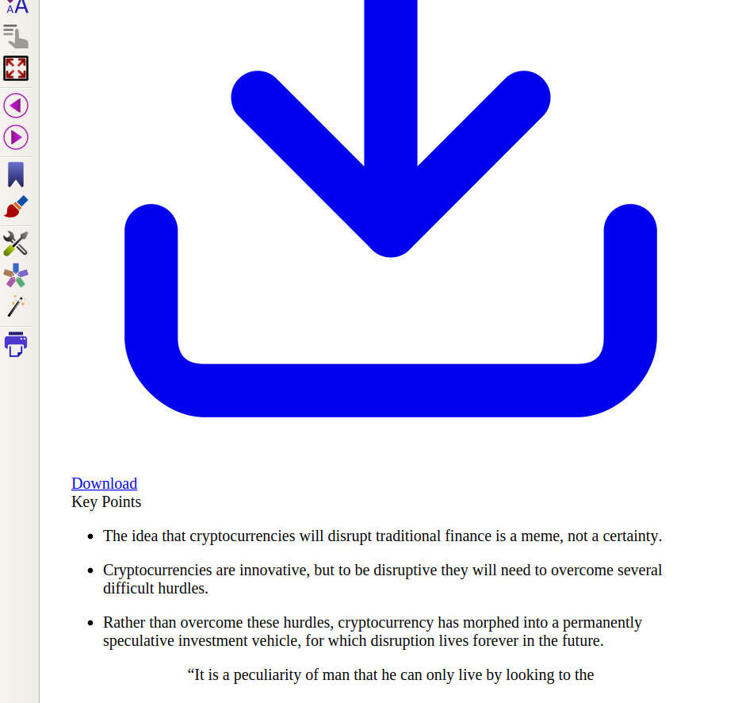
Ebook

Slide 112

Ebook

Slide 113
Ebook
# ebook.py
def main(title: str, input_path: Path) -> Path:
# make chapter
chapter = epub.EpubHtml(
title=title, content=input_path.read_text(), file_name="file1.xhtml"
)

Slide 114
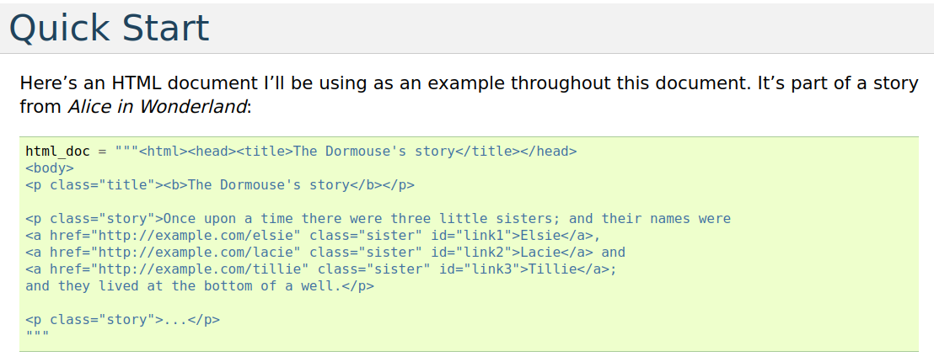
Beautiful Soup

Slide 115
<html><head><title>The Dormouse's story</title></head>
<body>
<p class="title"><b>The Dormouse's story</b></p>
<p class="story">Once upon a time there were three little sisters; and their names were
<a href="http://example.com/elsie" class="sister" id="link1">Elsie</a>,
<a href="http://example.com/lacie" class="sister" id="link2">Lacie</a> and
<a href="http://example.com/tillie" class="sister" id="link3">Tillie</a>;
and they lived at the bottom of a well.</p>
<p class="story">...</p>

Slide 116
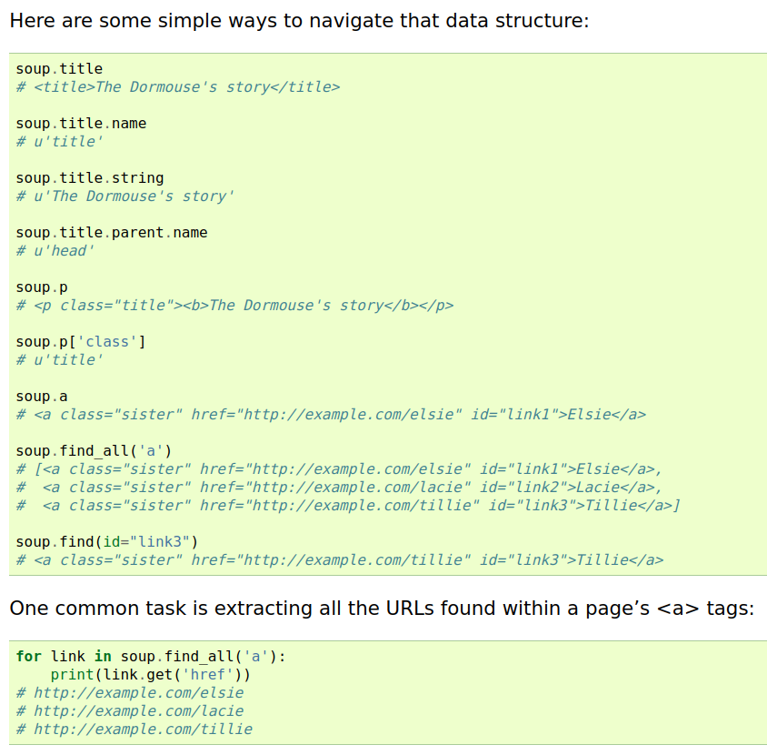
<html><head><title>The Dormouse's story</title></head>
<body>
<p class="title"><b>The Dormouse's story</b></p>
<p class="story">Once upon a time there were three little sisters; and their names were
<a href="http://example.com/elsie" class="sister" id="link1">Elsie</a>,
<a href="http://example.com/lacie" class="sister" id="link2">Lacie</a> and
<a href="http://example.com/tillie" class="sister" id="link3">Tillie</a>;
and they lived at the bottom of a well.</p>
<p class="story">...</p>

Slide 117


Slide 118
Ebook
# ebook.py
def main(input_path: Path, output_suffix: str = "") -> Path:
# make chapter
chapter = html_to_chapter(input_path)
...
def html_to_chapter(html_path: Path) -> epub.EpubHtml:
soup = bs4.BeautifulSoup(html_path.read_text(), features="html.parser")
[title_box] = soup.findAll(**{"class": "hero__box"})
[title_element] = title_box.findAll(**{"class": "hero__title"})
title = title_element.text
[publication_keypoints] = soup.findAll(**{"class": "publication__keypoints"})
[publication_body] = soup.findAll(**{"class": "publication__body"})
fname = f"{uuid.uuid4()}.xhtml"
content = f"{title_box}{publication_keypoints}{publication_body}"
return epub.EpubHtml(title=title, content=content, file_name=fname)

Slide 119
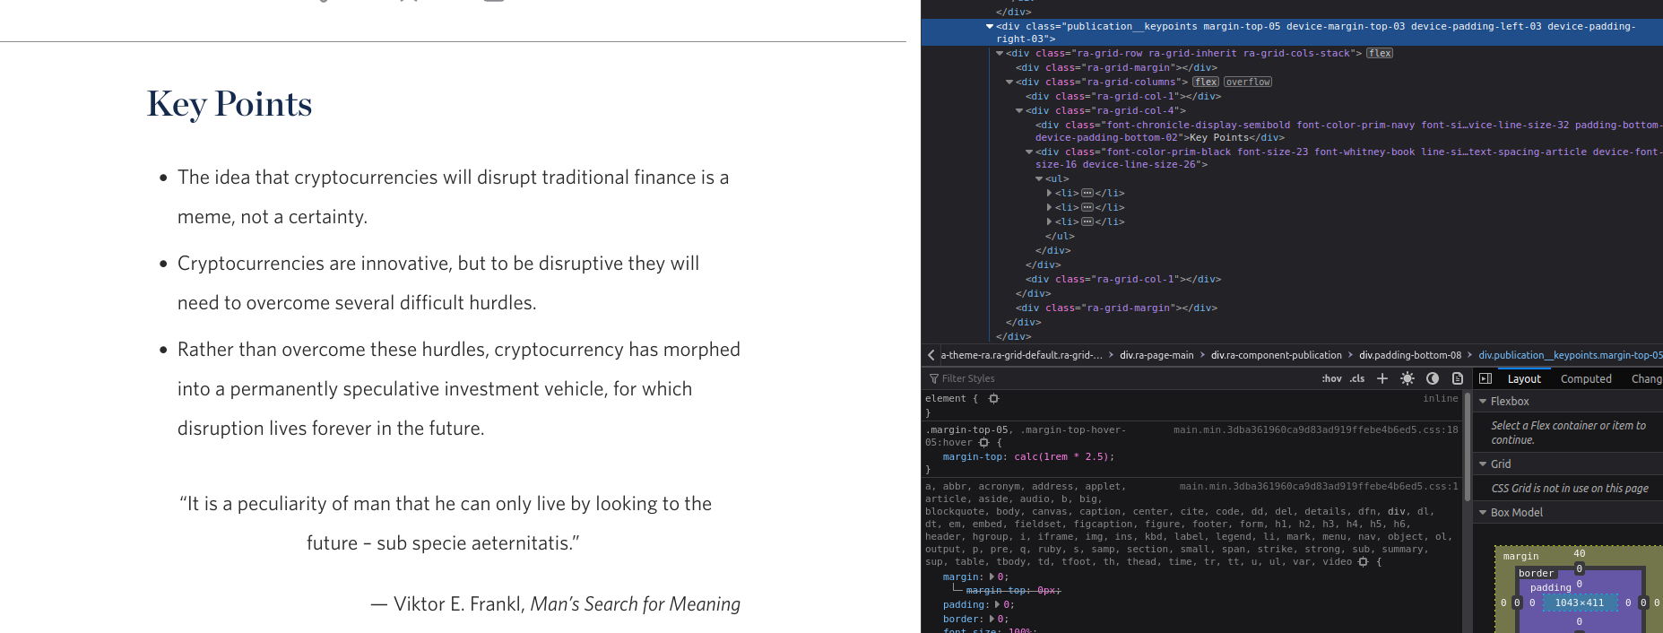

Slide 120
Ebook
https://www.researchaffiliates.com/publications/articles/913-cryptocurrencies-the-power-of-memes

Slide 121
Ebook
# ebook.py
def main(input_paths: tp.Iterable[Path], title: str) -> Path:
# make chapter
chapters = [html_to_chapter(path) for path in input_paths]
# make book
book = epub.EpubBook()
book.spine = ["nav"] + chapters
for c in chapters:
book.add_item(c)
book.toc = ((epub.Section(title), chapters),)
# add default Nav file
book.add_item(epub.EpubNav())
# write book
OUTPUT_DIR.mkdir(exist_ok=True)
output_path = OUTPUT_DIR / f"{title}.epub"
epub.write_epub(output_path, book)
return output_path

Slide 122
Conclusion
ebooklib
beautifulsoup / html

Slide 123
Python is an accessible scripting language!

Slide 124
Python is an accessible scripting language!
Simple Adding Script: input, sys.argv
Time Logging: loops, datetime, writing to a file
Bulk Image Organizer: Path, PIL, strptime
Jisho API: APIs, requests, JSON
EBook Writer: ebooklib, beautifulsoup, HTML
And so much more!

Slide 125
Python is an accessible scripting language!
Simple Adding Script: input, sys.argv
Time Logging: loops, datetime, writing to a file
Bulk Image Organizer: Path, PIL, strptime
Jisho API: APIs, requests, JSON
EBook Writer: ebooklib, beautifulsoup, HTML
And so much more!

Slide 126
Python is an accessible scripting language!
Simple Adding Script: input, sys.argv
Time Logging: loops, datetime, writing to a file
Bulk Image Organizer: Path, PIL, strptime
Jisho API: APIs, requests, JSON
EBook Writer: ebooklib, beautifulsoup, HTML
And so much more!

Slide 127
Python is an accessible scripting language!
Simple Adding Script: input, sys.argv
Time Logging: loops, datetime, writing to a file
Bulk Image Organizer: Path, PIL, strptime
Jisho API: APIs, requests, JSON
EBook Writer: ebooklib, beautifulsoup, HTML
And so much more!

Slide 128
Python is an accessible scripting language!
Simple Adding Script: input, sys.argv
Time Logging: loops, datetime, writing to a file
Bulk Image Organizer: Path, PIL, strptime
Jisho API: APIs, requests, JSON
EBook Writer: ebooklib, beautifulsoup, HTML
And so much more!

Slide 129

Python is an accessible scripting language!
Simple Adding Script: input, sys.argv
Time Logging: loops, datetime, writing to a file
Bulk Image Organizer: Path, PIL, strptime
Jisho API: APIs, requests, JSON
EBook Writer: ebooklib, beautifulsoup, HTML
And so much more!

Slide 130

Credits:
Cute pictures from https://www.irasutoya.com/

Slide 131
Other topics
When to not write a script?
When to transition from small program to large program?

